Slide 1
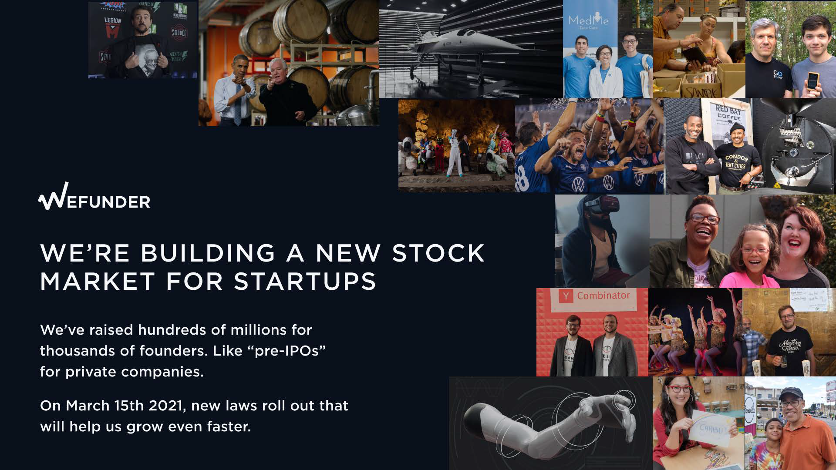

Slide 2
sx
year-over-year growth, Q4
On Wefunder, everyone can invest as little as $100
in startups they love
$205M
investment (GMV) annual run rate
$SM
revenue run rate
$5B
follow-on
investment in portfolio
41%
market share.
#1 market leader.
THE WHY NOW
New regulatory reforms
rolling out March 2021

Slide 3
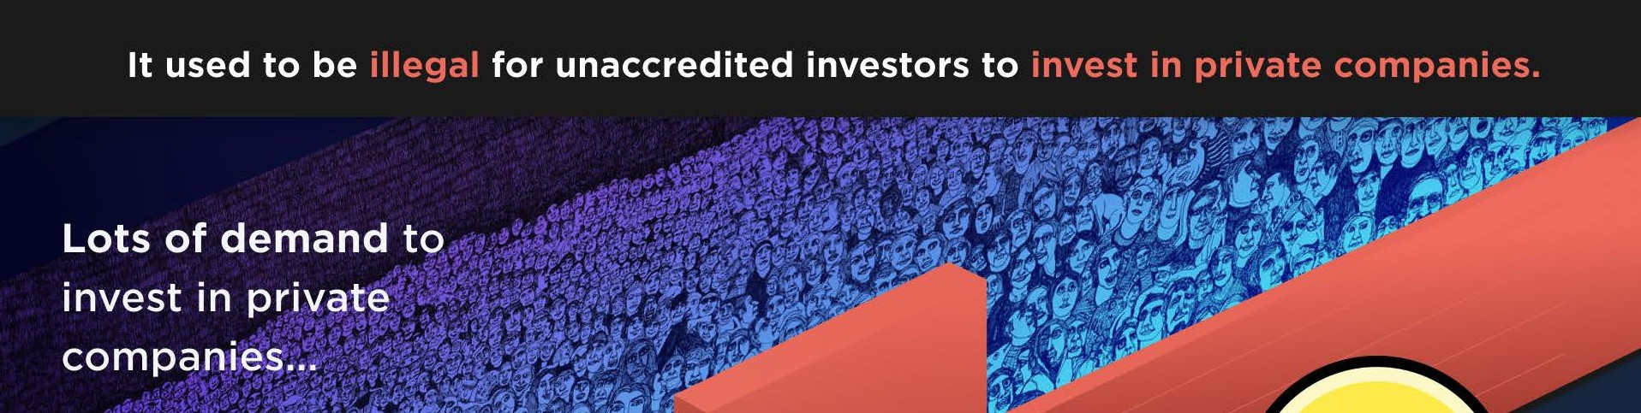

II
r'»

Slide 4
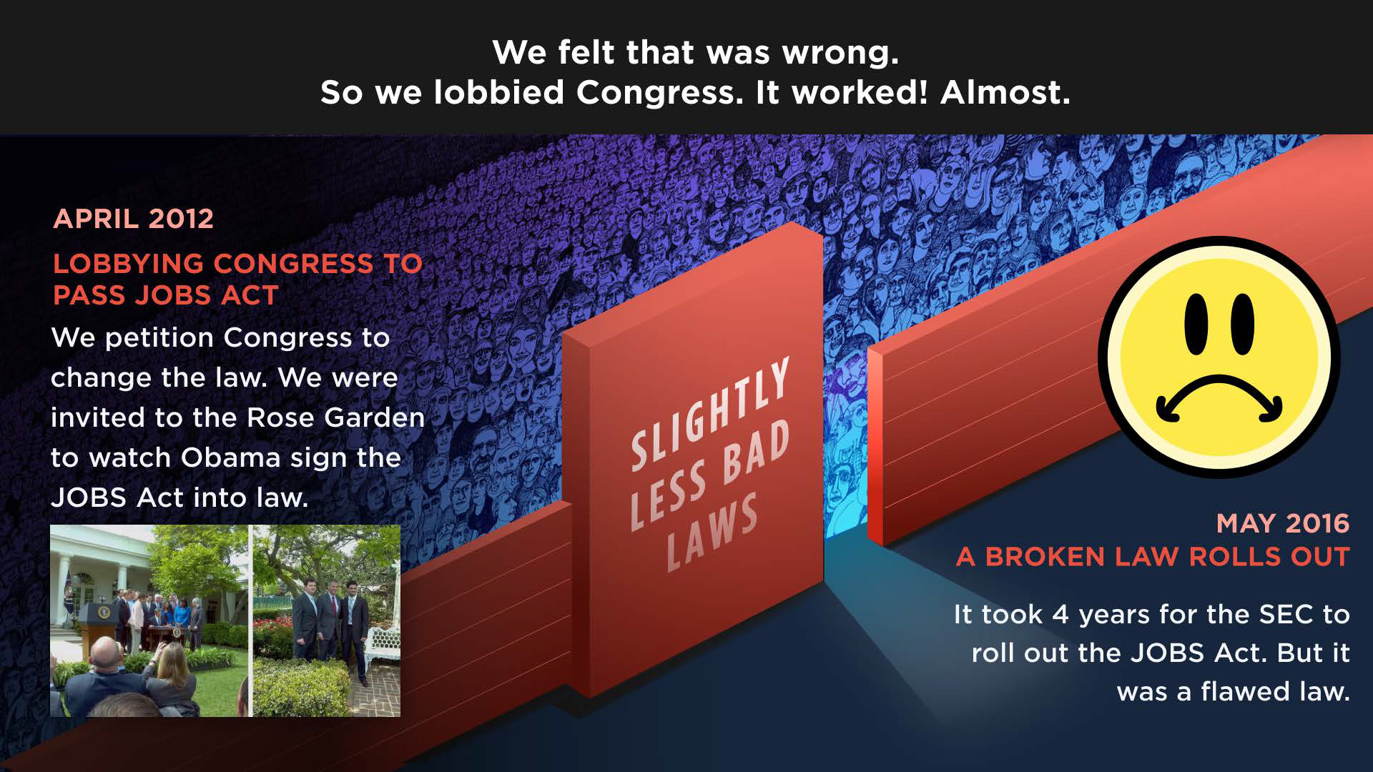

Slide 5
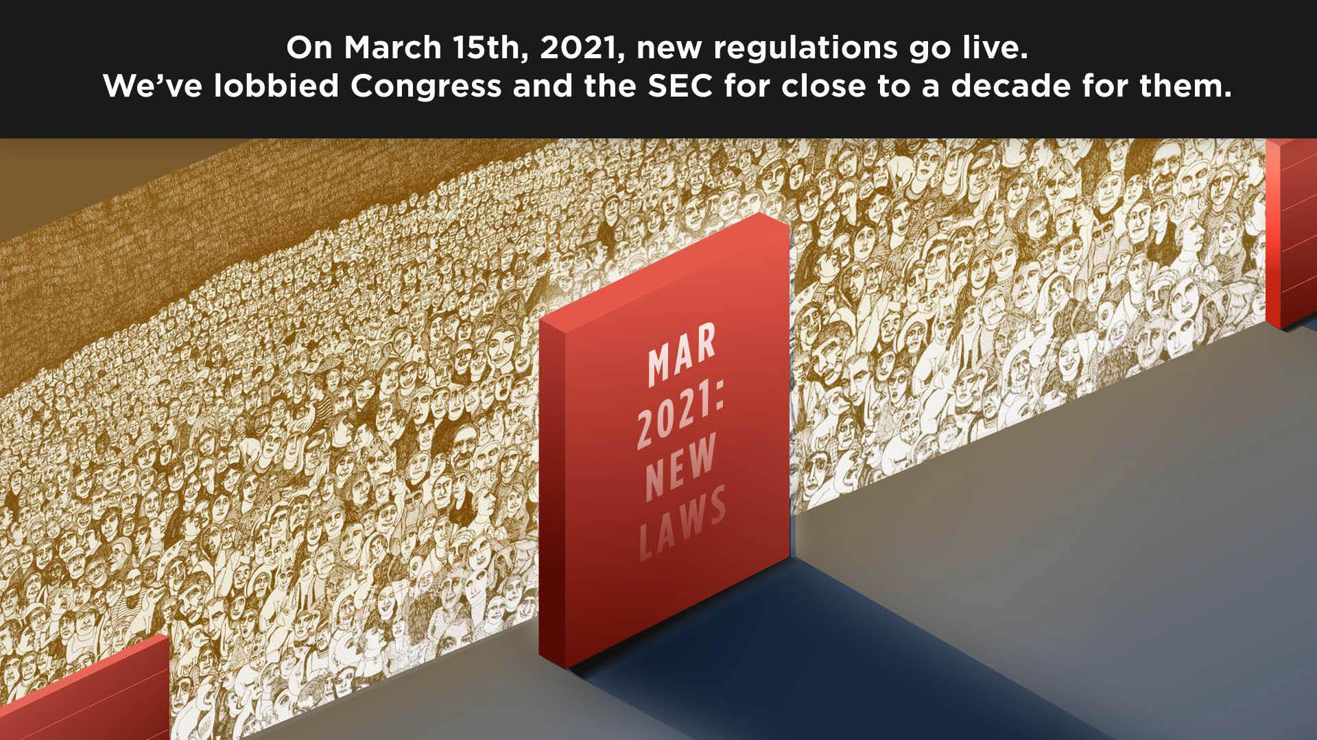

Slide 6
ON MARCH 2021, NEW REGULATIONS
GO LIVE
Companies can raise
$SM/yr | (Reg CF) or
$75M/yr (Reg A+)
from unaccredited
investors
Companies can
SPVs: One Entity
Anyone can take a
start a campaign
on Cap Table
test to become
in < 15 minutes
accredited
Unaccredited
Before, founders
investors
can now
It no longer is a
had to first do a
invest in a SPV.
requirement
to be
This will double our
few weeks of
Many more
wealthy
to be an
revenue almost
compliance
work.
startups
will be
accredited
investor.
immediately
an
d
Most dropped off.
willing
to use us
attract
better
with an SPV.
companies
to use us.

Slide 7
DELIVER
WE
CAN
NOW
ON OUR 2012 VISION
•
We're building a stock market where founders can raise
money
from their fans, while staying private.
(OnlyFans
meets Robinhood, if you will.)
•
We aim to make it standard for startups to raise up to $75M/YR
in a "pre-IPO" on Wefunder, allocated to their supporters.
•
Secondary
trades
happen
once every 9-18 months in a "long
term stock market" that lines up with traditional VC raises.

Slide 8





EFUNDER
$87M
We created this industry in 2012.
Then lobbied 9 years for regulatory reform.
$41.45M
INVESTMENTS ON WEFUNDER
$22.92M
$21.68M
$1₋.42M
- •
$15.49M
$4.89M
$8.33M
$514,800
2012
2013
2014
2015
2016
2017
2018
2019
2020
WE LOBBY CONGRESS
We petitioned Congress & shaped law.
Invited to watch Obama sign the JOBS Act.
LAUNCH TO ACCREDITED INVESTORS
It took 4 years for the SEC to write the rules for the JOBS Act. While waiting, we built a platform for accredited investors to invest in mostly YC startups.
LAW GOES LIVE FOR EVERYDAY INVESTORS
Mid-2016, it became legal for anyone to invest. But the rules were bad for startup founders. It was also a brutal slog in '16-'18 to build the payment and compliance infrastructure.
REGULATORY REFORM
On November 2020, the SEC
announces fixes to the laws - to be rolled out March 15th 2021

Slide 9
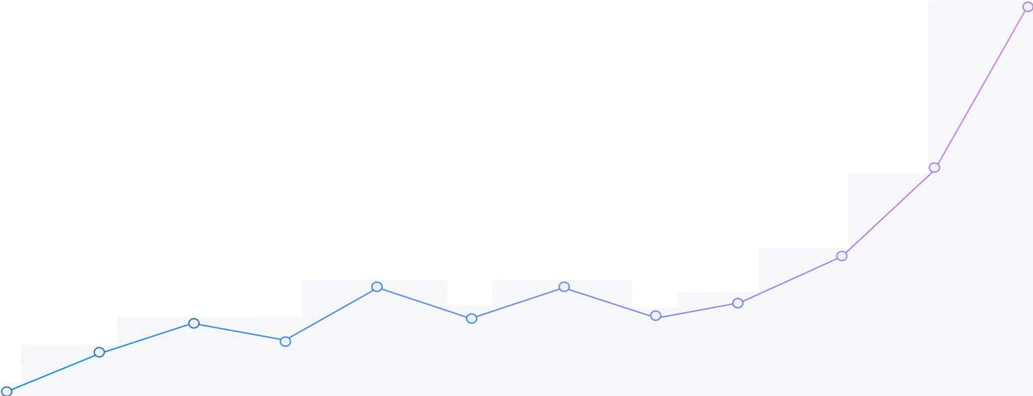
Our growth has accelerated in advance of the reforms that go live on March 15th 2021
WEFUNDER
$38 .SM
$ 23 .SM
$14 .GM
$11. GM
$ 11.GM
$10 . GM
$ 8 .l M
$ 8 . GM
$ 9 . 3 M
$ 5 .l M
$1. SM
$ 6 .7 M
Ql | Q2 | Q3 | Q4 | Ql | Q2 | Q3 | Q4 | Ql | Q2 | Q3 | Q4
2018 | 2018 | 2018 | 2018 | 2019 | 2019 | 2019 | 2019 | 2020 | 2020 | 2020 | 2020
INVESTMENTS ON WEFUNDER

Slide 10
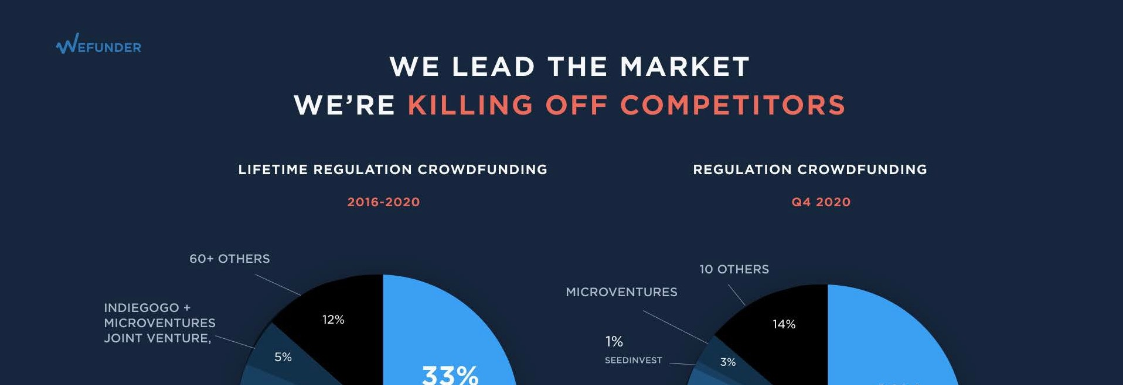
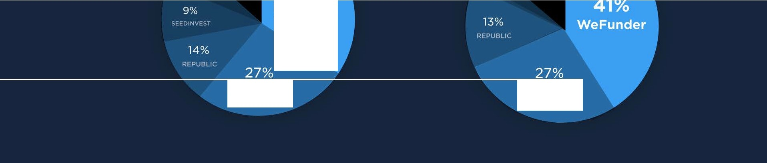
WeFunder
STARTENGINE
STARTENGINE

Slide 11



We've recruited about a million new angel investors
WEFUNDER
"Being a shareholder of Modern Times has changed my entire relationship with my favorite brewery. Buying Modern Times beer at the grocery store brings me so much joy."
"My dog Scooby just passed away due to Lymphoma, so I wanted to do something even if it was only a tiny little bit to help develop treatment to cure Lymphoma in dogs."
"I have known Stephanie for 15 year s. She is one of the kin dest, hardest working, and most
passionate individuals I have ever met. She is such a driven person. I have no doubt that any venture she embarks upon will be wildly successful."

Slide 12
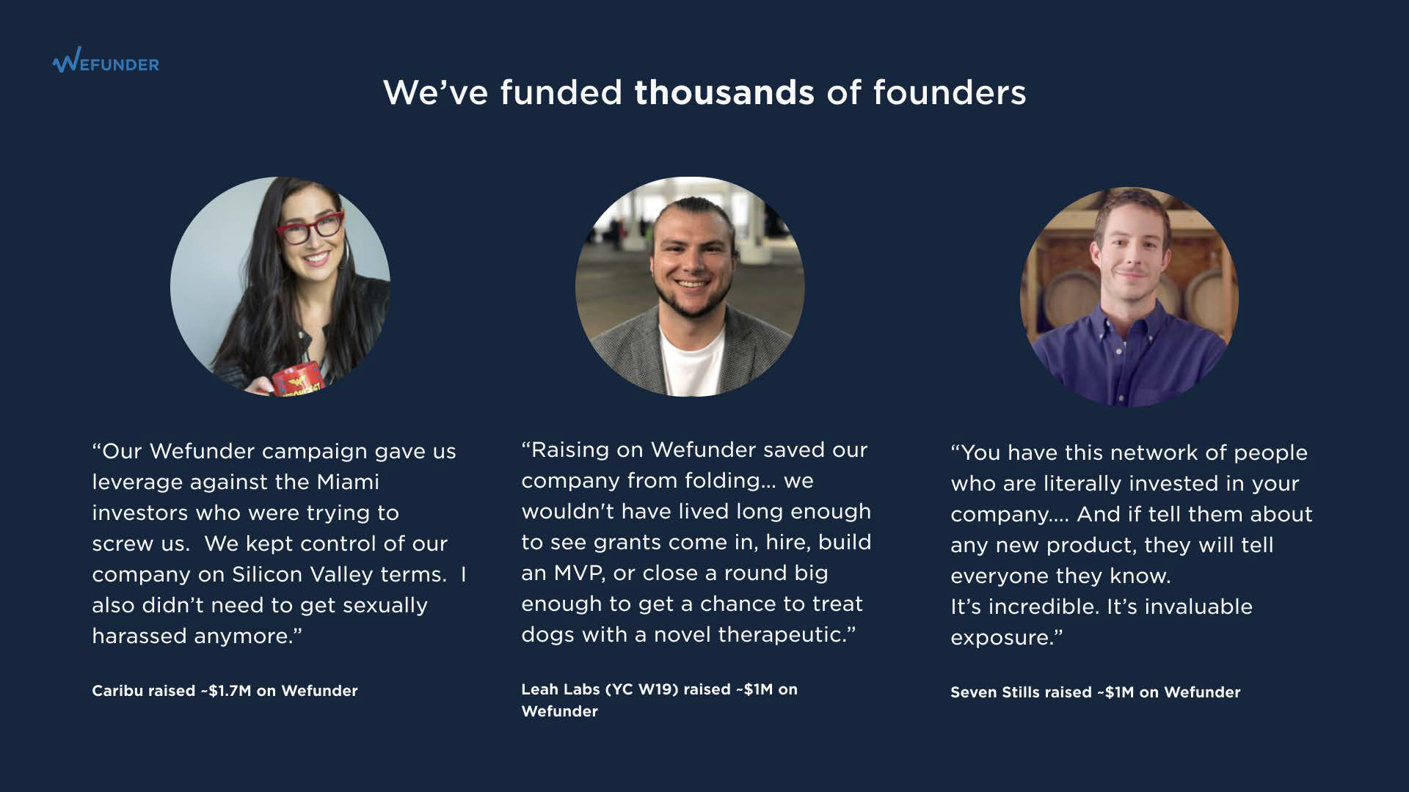

Slide 13


WEFUNDER
Over $5 billion has been invested in startups after they were first funded on Wefunder
Award-winning brewery with $30M in revenues
1111111 L
Interactive art installaations with
$100M+ follow-on
LEGIDNlif
Movie studio with over 25,000 investors on Wefuner
eta ionics
Artificial pancreas with $100M+ follow-on funding
FOR MORE
WEFUNDER.COM/ RESU LTS

Slide 14
2021 Goals
WEFUNDER
At least $350 million in investments in 2021 (GMV)
European launch the first day it's legal: 11/10/21
2.SX headcount to 75, 40% engineers & designers
Redesign of Wefunder.com (it was kludged together by CEO in 2015)
Build a predictable referral engine & sales process
Invest in founder and lead investor communities to increase deal flow

Slide 15


Our goal is to at least 3x again by Dec '21
WEFUNDER
New SEC regulatory reforms go live March 2021*
$SOM
X 12 = $600M
ANNUAL FUNDING RUN RATE (GMV) IN DEC 2021
$SOM
ACTUAL INVESTMENTS
OUR GOAL
X
8.5% AVG FEE (TAKE RATE)
--
$SOM+
ANNUAL REVENUE RUN RATE
$16.163,369
$3,231,212
DEC 2019
DEC 2020
DEC2021

Slide 16
To 3 X, we must launch 100 startups per month
On March 15th 2021, the maximum fundraise per year increases to $SM from $1M.
We expect our average raise to almost immediately double.
2020
2021 GOAL
44
COMPANIES
100
COMPANIES
$225,000
$500,000
X
AVERAGE RAISE
2016-2020
AVERAGE RAISE ($SM CAP)
LAUNCHED IN DEC 2020
Need to launch per month to hit 3x goal
=
248 companies are already preparing to launch on March 15th
$SOM

Slide 17
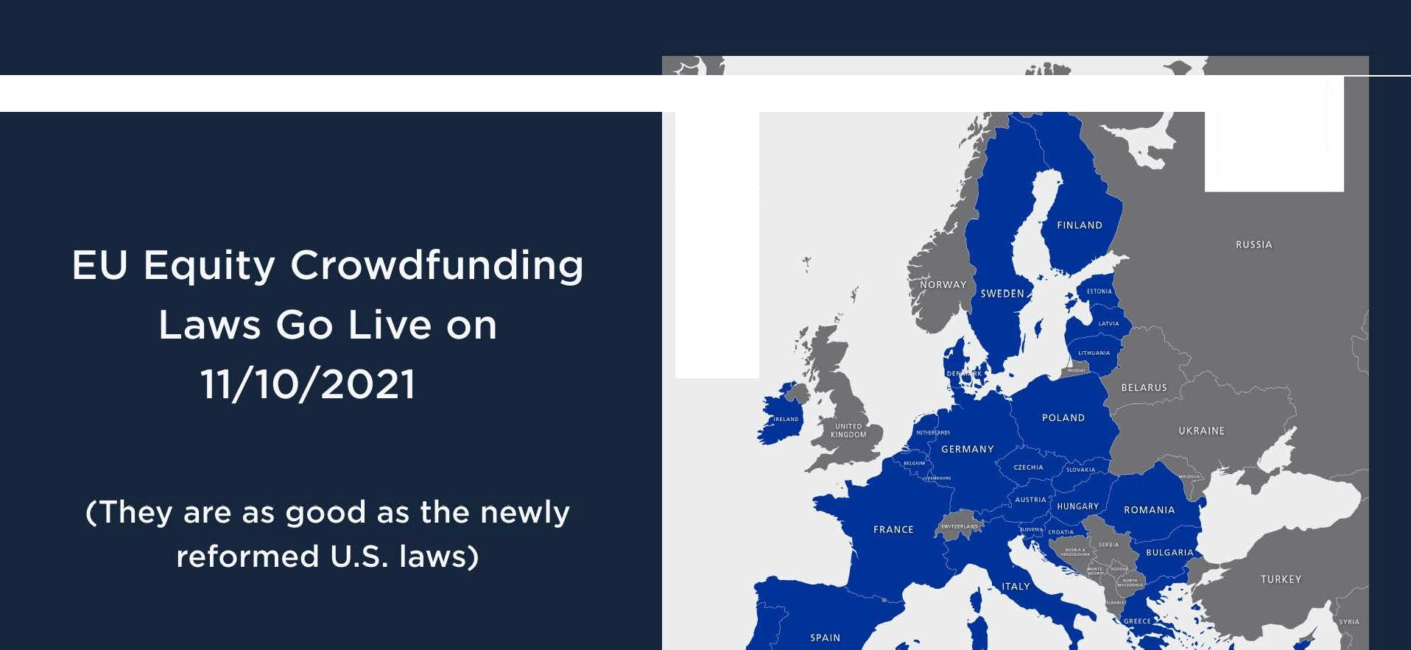

•*•
* *
* *
** * **
EU member states
!CELANO
- .
I

Slide 18
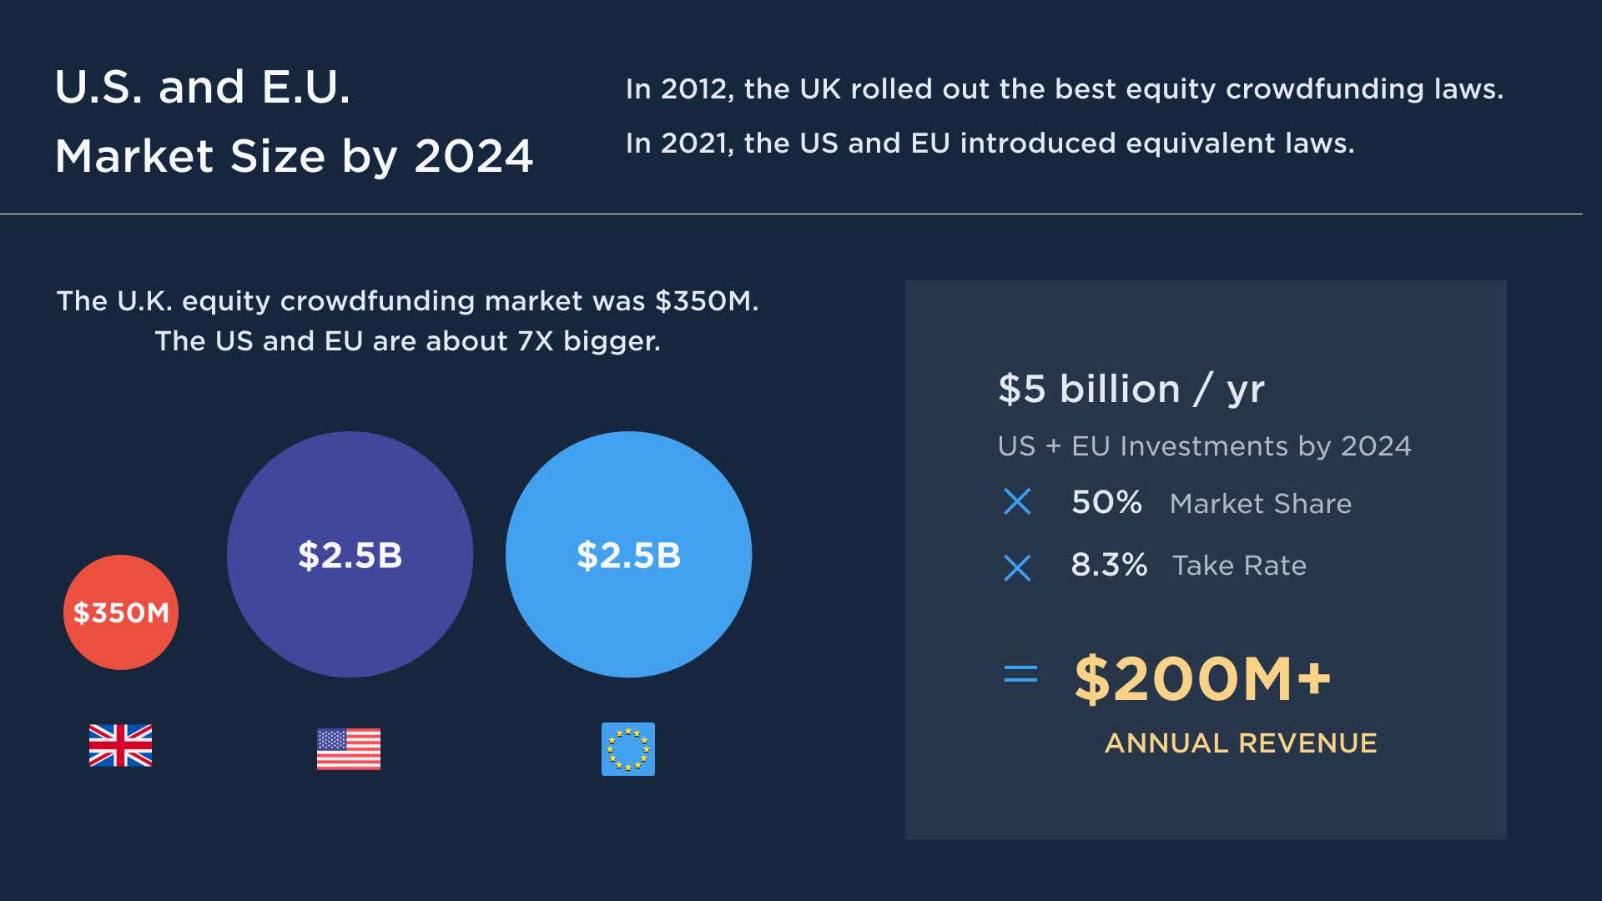

Slide 19
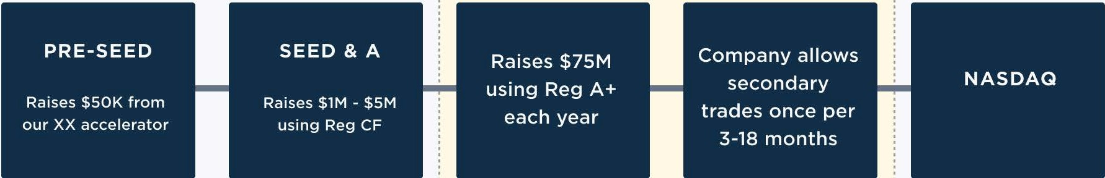
Where do we go after 2024?
··--·---------------------------------------·················-----------•.
Early Stage Primary Offerings
Reg A+ IPOs and Secondary Market
WE EXPECT ENOUGH LIQUIDITY BY 2024
IPO
CURRENT FOCUS
Startups can use Reg D and Reg A+ to stay 'private' while allowing limited public sales & liquidity to employees & investors.
Our stock market will be designed to encourage long-term thinking.
.
·---------------------·-···--·-------------------·-----------------------·

Slide 20
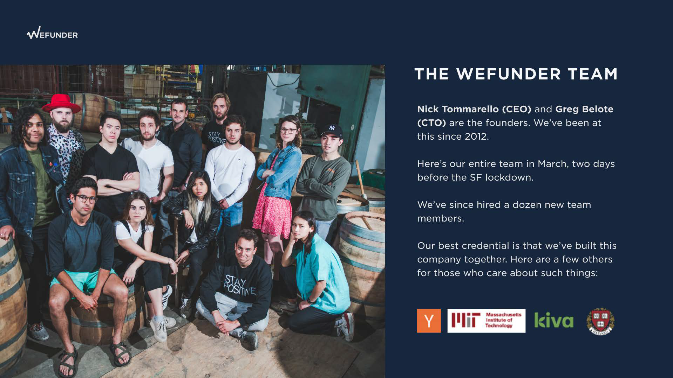

Slide 21
JOIN THE MOVEMENT
WEFUNDER
We're fixing capitalism by spreading the Silicon Valley
fairy dust - the good parts - to the world.
We'll help tens of thousands more founders take their
shot, while creating millions of new angels that invest in
the next generation. Visit wefunder.com/charter
One of the most powerful forces in the world is when
someone believes in you... and backs it up by investing
even $100 of their own money. We scale that magic.
We spent a decade working towards this moment. We
had the grit and tenacity to survive the hard times until
regulatory
reform.
Now we'll execute at scale.

